Slide 1

By Panagiotis Axiotis

Slide 2

Agenda
Identified Problems
Proposed Solutions
AWS Migration
Conclusion and Next Steps

Slide 3
Identified Problems
App’s technical and logical flaws
Technical
Authentication
RESTful endpoints that require current user ID’s are redundant and unsecure
Checks if the same Password exists on registration
Sensitive Personal Data Handling(GDPR)
Logical
Login endpoint doesn’t work

Slide 4
Proposed Solution - Authentication
JWT Architecture
Client
Server
Login Form
Creates a token with a secret
Token
Token Auth Header
Response
Check Token signature, and Get user info from the Token

Slide 5
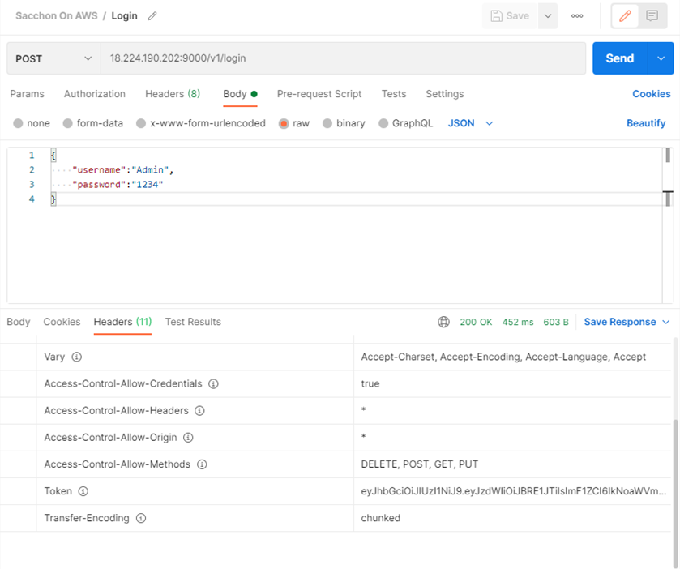
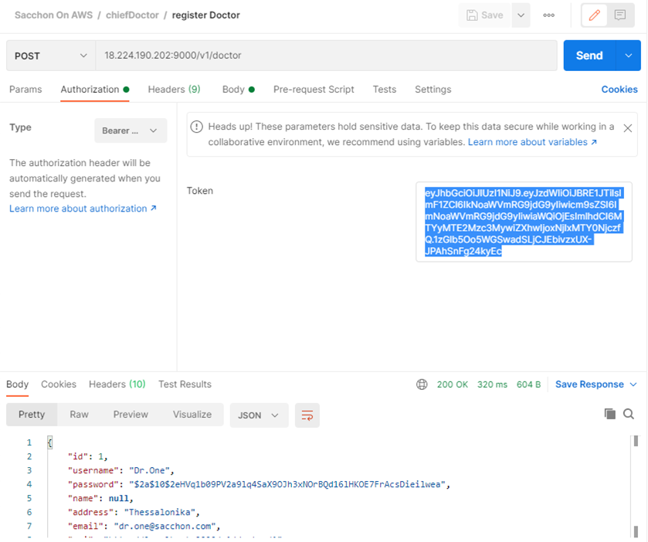
Proposed Solution - Authentication
JWT
Client
Server
Token Auth Header
Login Form
Token

Slide 6
Proposed Solution – Safety and Duplication
BCrypt Password Hashing
Get ID’s from JWT and not from URI
Check if email already exists on registration

Slide 7
AWS Migration
Built a Jar file with all the dependencies
Created 2 new Security Groups in AWS
Created an EC2 Instance for the Java Application(Jar File)
Created an RDS Microsoft SQL Instance
Created a Linux service and a Bash file and started the Service

Slide 8
Conclusions and Next Steps
Conclusions
JWT has been applied so that is not required username and password to be send in every request.
BCrypt Hashing has been applied for users password encryption.
ID is retrieved from JWT resulting in quicker and safer access.
New user registration is checks if email exist in database.
Next Steps
GDPR

